Slide 1

Chapter 4: Project Integration Management
Information Technology Project Management, Eighth Edition

Slide 2
The Key to Overall Project Success: Good Project Integration Management
Project managers must coordinate all of the other knowledge areas throughout a project’s life cycle
Many new project managers have trouble looking at the “big picture” and want to focus on too many details (See opening case for a real example)
Project integration management is not the same thing as software integration

Slide 3
Project Integration Management Processes
1. Developing the project charter involves working with stakeholders to create the document that formally authorizes a project—the charter.
2. Developing the project management plan involves coordinating all planning efforts to create a consistent, coherent document—the project management plan.
3. Directing and managing project work involves carrying out the project management plan by performing the activities included in it.

Slide 4
Project Integration Management Processes (cont’d)
Monitoring and controlling project work involves overseeing activities to meet the performance objectives of the project
Performing integrated change control involves identifying, evaluating, and managing changes throughout the project life cycle.
Closing the project or phase involves finalizing all activities to formally close the project or phase.

Slide 5
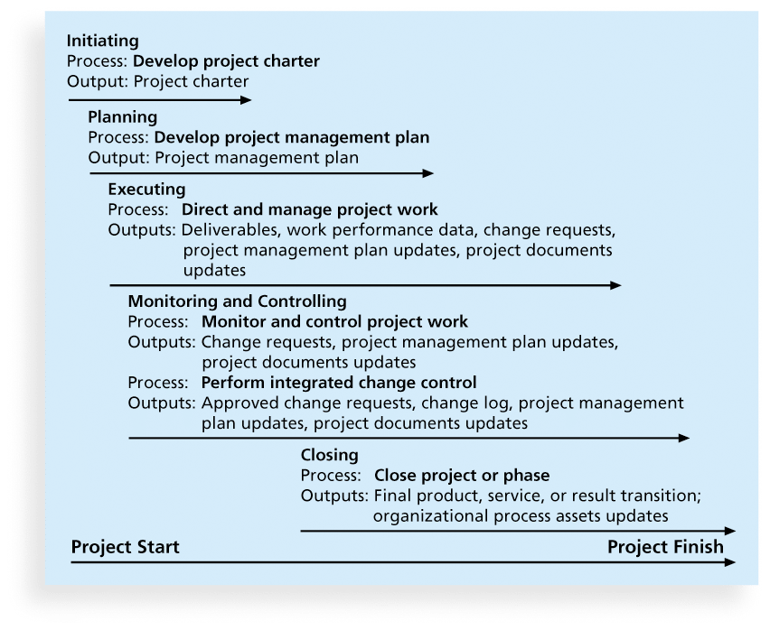
Figure 4-1. Project Integration Management Summary

Slide 6
Project Execution Tools and Techniques
Expert judgment: Experts can help project managers and their teams make many decisions related to project execution
Meetings: Meetings allow people to develop relationships, pick up on important body language or tone of voice, and have a dialogue to help resolve problems.
Project management information systems: There are hundreds of project management software products available on the market today, and many organizations are moving toward powerful enterprise project management systems that are accessible via the Internet
See the What Went Right? example of Kuala Lumpur’s Integrated Transport Information System on p. 169

Slide 7
Monitoring and Controlling Project Work
Changes are inevitable on most projects, so it’s important to develop and follow a process to monitor and control changes
Monitoring project work includes collecting, measuring, and disseminating performance information
A baseline is the approved project management plan plus approved changes

Slide 8
Performing Integrated Change Control
Three main objectives are:
Influencing the factors that create changes to ensure that changes are beneficial
Determining that a change has occurred
Managing actual changes as they occur

Slide 9
Change Control on Information Technology Projects
Former view: The project team should strive to do exactly what was planned on time and within budget
Problem: Stakeholders rarely agreed up-front on the project scope, and time and cost estimates were inaccurate
Modern view: Project management is a process of constant communication and negotiation
Solution: Changes are often beneficial, and the project team should plan for them

Slide 10
Change Control System
A change control system is a formal, documented process that describes when and how official project documents and work may be changed
Describes who is authorized to make changes and how to make them

Slide 11
Change Control Board (CCB)
A change control board is a formal group of people responsible for approving or rejecting changes on a project
CCBs provide guidelines for preparing change requests, evaluate change requests, and manage the implementation of approved changes
Includes stakeholders from the entire organization

Slide 12
Making Timely Changes
Some CCBs only meet occasionally, so it may take too long for changes to occur
Some organizations have policies in place for time-sensitive changes
“48-hour policy” allows project team members to make decisions, then they have 48 hours to reverse the decision pending senior management approval
Delegate changes to the lowest level possible, but keep everyone informed of changes

Slide 13
Configuration Management
Configuration management ensures that the descriptions of the project’s products are correct and complete
Involves identifying and controlling the functional and physical design characteristics of products and their support documentation
Configuration management specialists identify and document configuration requirements, control changes, record and report changes, and audit the products to verify conformance to requirements
See www.icmhq.com for more information

Slide 14
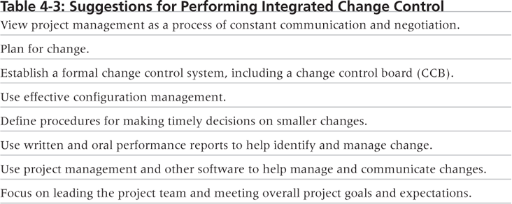
Table 4-3. Suggestions for Performing Integrated Change Control

Slide 15
Closing Projects or Phases
To close a project or phase, you must finalize all activities and transfer the completed or cancelled work to the appropriate people
Main outputs include
Final product, service, or result transition
Organizational process asset updates

Slide 16
Using Software to Assist in Project Integration Management
Several types of software can be used to assist in project integration management
Documents can be created with word processing software
Presentations are created with presentation software
Tracking can be done with spreadsheets or databases
Communication software can facilitate communications
Project management software can pull everything together and show detailed and summarized information

Slide 17
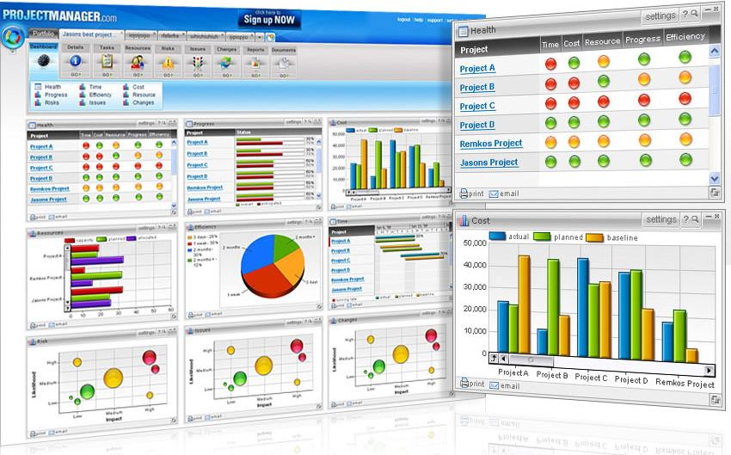
Figure 4-8. Sample Portfolio Management Software Screen
Source: www.projectmanager.com

Slide 18
Chapter Summary
Project integration management involves coordinating all of the other knowledge areas throughout a project’s life cycle
Main processes include
Develop the project charter
Develop the project management plan
Direct and manage project execution
Monitor and control project work
Perform integrated change control
Close the project or phase

